Slide 1
Unit 1 Introduction to
Intercultural Communication

Slide 2
1 What is Intercultural Communication?
2 What challenges does China have/Why does China need intercultural communication?

Slide 3
(一）What is intercultural communication
SCENARIO
Zhao Xin invited his new American colleague Mr. Smith to his house for dinner. It was supposed to be a happy dinner, but things turned out differently. Read the dialogues to find out what happened and answer the following questions.
(1) Mr. Smith arrives and rings the doorbell.
Zhao Xin: Wow! Welcome, Mr. Smith.
Mr. Smith: Thank you so much.
Zhao Xin: Allow me to introduce you. This is my wife, Liu Weiwei. Weiwei, this is Mr. Smith.
Mr. Smith: (to Liu Weiwei) Nice to meet you, Weiwei. You look gorgeous!
Liu Weiwei: (shy) Er ... not at all.
Mr. Smith: (embarrassed) I mean ...

Slide 4
A cross-cultural view
SCENARIO
(2) At the table.
Mr. Smith: Wow! So many dishes! All look terrific! I like Chinese food.
Zhao Xin: Just some simple dishes. They might not be delicious. I hope you won’t mind.
Mr. Smith: How come? I think they are very delicious. (Then he is full and puts down the chopsticks.)
Liu Weiwei: Mr. Smith, please have some more. Make yourself at home.
Mr. Smith: Thank you. I’m really full.
Zhao Xin: Come on! Please have some more.
Mr. Smith: Thank you, but …
(3) On his way home, Mr. Smith talks to his American friend on the phone.
His friend: How was your visit to the Chinese family?
Mr. Smith: (with a sigh) You know what? I think the Chinese couple were kind of weird. It made me feel a little bit uncomfortable.

Slide 5
A cross-cultural view
SCENARIO
Questions
Why did Mr. Smith think the Chinese couple were kind of weird?
What are the cultural values behind the Chinese couple’s way of treating the guest?

Slide 6
A cross-cultural view
SCENARIO
Questions
Why did Mr. Smith think the Chinese couple were kind of weird?
He praised Liu Weiwei, but she “denied” the praise. When he was really full, the Chinese couple still asked him to eat more.

Slide 7
A cross-cultural view
SCENARIO
Questions
What are the cultural values behind the Chinese couple’s way of treating the guest?
The Chinese couple’s way of treating the guest reflects such traditional Chinese cultural values as modesty, generosity and hospitality.

Slide 8
A cross-cultural view
CROSS-CULTURAL UNDERSTANDING
Cultural awareness
In the scenario, both Mr. Smith and the Chinese couple have every intention to be polite rather than rude according to the rules of their respective cultures. However, things turned out to be embarrassing and unpleasant. The problem lies in their lack of cultural awareness.
What is cultural awareness?
It refers to the knowledge, awareness, and acceptance of other cultures and other people’s cultural identities. Specifically, it includes the willingness, ability and sensitivity required to understand people with different backgrounds, and the acceptance of diversity.

Slide 9
A cross-cultural view
CROSS-CULTURAL UNDERSTANDING
Cultural awareness
Why do people lack cultural awareness?
People lack cultural awareness probably because they are so close to their own culture and may not be aware that their patterns of behavior are not universal. So when coming into contact with people from another culture, they may not be aware of the cultural differences and behave according to the norms of their own culture.
How to improve your cultural awareness?
First, distinguish between intercultural communication (involving people of different cultural backgrounds) and monocultural communication (involving people of common behavior, language and values). Second, develop respect for cultural differences. Third, be aware that cultural differences usually lie in different cultural values, not just in observable behavior. Fourth, avoid immediate evaluation and don’t use the norms of your own culture to judge the behavior of people from other cultures.

Slide 10
（二）Challenges for China in ICC
(Why does China need ICC?)

Slide 11
Western media perspectives
CASE STUDY
Eating with chopsticks
International enterprises are important participants in cross-cultural communication. In order to better attract and persuade the target audiences of other countries and to create a good brand image, international enterprises need to give full play to the role of advertisements.
Cultural awareness is important to advertisements aiming at the audiences of other countries. A good and effective advertisement should take the cultural characteristics of the target country into consideration. Otherwise, the advertiser will suffer from criticism and even boycotts. Let’s take a look at a series of advertisements named Eating with Chopsticks (《起筷吃饭》) launched by the Italian luxury fashion brand Dolce & Gabbana (D&G) in 2018.
The advertisements, composed of three short videos, were aimed at the Chinese market. They were published on social media platforms such as Sina Weibo, Instagram and Facebook to promote D&G’s upcoming Shanghai Fashion Show.
Notes:
注意这里有一些特殊的设计，是参考教材设计来的。U1也需要参考教材

Slide 12
Western media perspectives
CASE STUDY
The videos feature a Chinese woman in a lavish D&G dress attempting to eat Italian food: pizza, cannoli and spaghetti. With Chinese folk music in the background, the male voice-over instructs the woman how to “properly” eat the Italian dishes with chopsticks, in a condescending tone. The woman looks surprised, perplexed and clumsy when performing this task.
The original voice-over of the advertisements is in Chinese and the English translation is mainly adapted from a commentary article of Giovanna Puppin, Lecturer at the University of Leicester. The following excerpts are from the translation.
Notes:
注意这里有一些特殊的设计，是参考教材设计来的。U1也需要参考教材

Slide 13
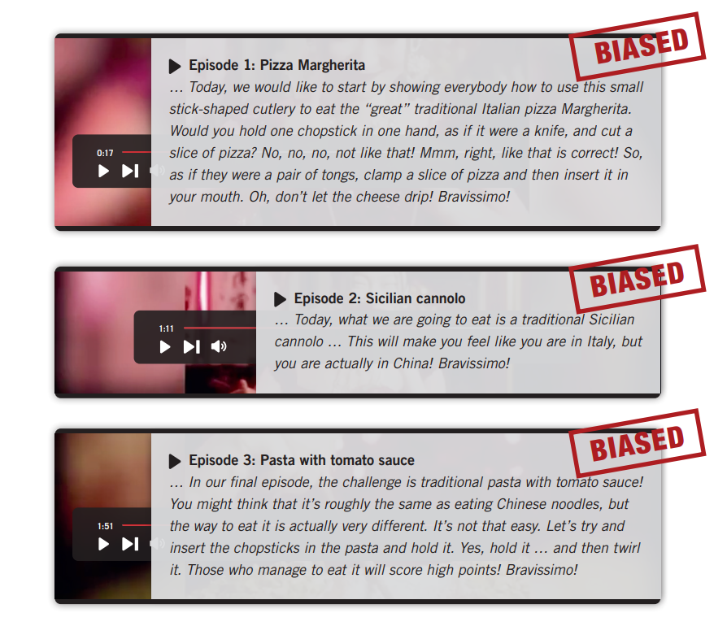
Western media perspectives
CASE STUDY

Slide 14
Western media perspectives
CASE STUDY

Slide 15
Western media perspectives
CASE STUDY
Discussion
Work in pairs to discuss the following questions.
Why did D&G’s advertisement series enrage Chinese people?
What are the possible reasons for D&G to portray chopsticks, a symbol of Chinese traditional culture, in this way?

Slide 16
Western media perspectives
CASE STUDY
Discussion
Work in pairs to discuss the following questions.
Why did D&G’s advertisement series enrage Chinese people?
It highlighted the Italian brand’s sense of “superiority” by portraying the traditional Chinese cultural symbol – chopsticks – in a disrespectful and derogatory way.

Slide 17
Western media perspectives
CASE STUDY
Discussion
Work in pairs to discuss the following questions.
What are the possible reasons for D&G to portray chopsticks, a symbol of Chinese traditional culture, in this way?
The first reason may be their intention of describing themselves as being more advanced, important or desirable, which is conducive to expanding their influences and serving their interests. Next is their ignorance of Chinese culture. Their limited knowledge of China results in their simplification and misinterpretation of China and Chinese culture. The third reason is their lack of cultural awareness.

Slide 18
Western media perspectives
MEDIA LITERACY
Ethnocentrism
The advertising campaign of D&G highlights the Italian brand’s sense of “superiority.” It portrays Chinese culture in a disrespectful and derogatory way. This is a typical sign of ethnocentrism and has hurt the feelings of Chinese people.
How is ethnocentrism embodied in the ads?
In terms of content:
The Chinese model is portrayed inappropriately, reinforcing an undereducated and unintelligent stereotype of Chinese women.
The male narrator is dominant, speaking with a condescending and prescriptive tone, and there is no voice of the Chinese model.
With regard to language:
The use of personal pronouns.
The use of rhetorical devices, such as analogies.
The use of some sentence patterns.

Slide 19
Western media perspectives
MEDIA LITERACY
What are the possible reasons for some Western brands such as D&G to display ethnocentrism toward China?
Their intention of describing themselves as being more advanced, important or desirable.
Their ignorance of Chinese culture.
Their lack of cultural awareness.
So, as audiences, we need to keep an eye on international enterprises’ ads to identify their potential bias against other cultures, and find out the possible reasons behind the bias.

Slide 20
Western media perspectives
Key concept(s)
ethnocentrism 种族中心主义
Ethnocentrism refers to the behavior or belief that favors the nation, culture, or group to which one belongs, often accompanied by feelings of dislike for other groups. Influenced by ethnocentrism, one usually regards his or her own culture as “more appropriate, natural, correct and good” and regards other cultures as “inferior and abnormal.” So ethnocentrism is very likely to lead to pride in one’s own culture and prejudice against other cultures.
种族中心主义指的是偏袒自己所属的民族、文化或群体的行为或信仰，通常伴有对其他群体的厌恶情绪。在种族中心主义的影响下，人们通常会认为自己的文化“更合适、更自然、更正确、更好”，认为其他文化“低劣、不正常”。 所以，种族中心主义很可能导致人们为自己的文化感到骄傲，对其他文化产生偏见。

Slide 21
Western media perspectives
Knowledge points
International enterprises are important participants in cross-cultural communication. 跨国企业是跨文化交流的重要参与者。
Cultural awareness is important for international enterprises to launch advertisements aiming at the audiences of other countries. 跨国企业在针对其他国家的目标受众投放广告时，文化意识十分重要。
Praising one’s own culture while belittling another culture or celebrating one’s own culture while using another culture as an inferior backdrop is a typical sign of ethnocentrism, which often leads to failure in cross-cultural and international communication. 赞扬自己的文化而贬低另一种文化，或赞美自己的文化而把另一种文化当作低等的衬托，这是典型的种族中心主义，易导致跨文化交际和国际传播的失败。
Ethnocentric people tend to identify with “in-group” people and judge “out-group” people in a negative light.种族中心主义者倾向于认同“群体内”的人，并以负面的眼光评判“群体外”的人。

Slide 22
Western media perspectives
Knowledge points
Ethnocentrism can be seen as making false assumptions about others based on one’s own limited knowledge and experience. 种族中心主义可以看做是基于自己有限的知识和经验对他人做出错误的假设。
Ethnocentrism is closely related to stereotype since stereotyping is a commonly used practice for ethnocentric people to deal with the unknown or their own ignorance in international communication. 种族中心主义与刻板印象密切相关，抱有刻板印象是种族中心主义者在国际交往中应对未知或自身无知的一种常见做法。
Due to the political, economic and military advantages of the West since modern times, some Western countries used to view other cultures with a condescending attitude. 由于近代以来西方在政治、经济、军事等方面的优势，一些西方国家习惯于以一种居高临下的态度看待其他文化。

Slide 23
Case
Do you know what a stereotype is? How does it do harm to cross-cultural communication?
Have you watched the Beijing 2022 Winter Games? Can you tell any features of the Games?
Can you tell something about the national fitness campaign in China?

Slide 24
A cross-cultural view
SCENARIO
It is at the gym of a college in Boston. Chen Xue, a Chinese student who came to the US just a month ago, is running on a treadmill. Her Canadian classmate Sarah comes to her. Read the dialogue and answer the following questions.
Sarah: Hi, Chen Xue. I didn’t expect to meet you here. You don’t look athletic. Do you come here often?
Chen Xue: Ha-ha! I come here three times a week. Actually, I was in my high school tennis team back home.
Sarah: Tennis team? Instead of a ping-pong team?
Chen Xue: Yes, almost all sorts of ball games are popular in China. And the Beijing Winter Olympics has also made ice and snow activities popular across the country.
Sarah: That’s cool! I like sports, too. Hey, can you teach me Chinese gongfu someday?
Chen Xue: I’m sorry. I’ve never practiced gongfu before.

Slide 25
A cross-cultural view
SCENARIO
Sarah: (shocked) You can’t practice Chinese gongfu? What a pity! What other sports do you like?
Chen Xue: Oh, I’ve been practicing gymnastics since seven.
Sarah: Gymnastics? Luckily, you are not among those Chinese gymnastic girls who receive harsh and cruel training.
Chen Xue: (astonished) What?

Slide 26
A cross-cultural view
SCENARIO
Questions
Why does Sarah mention the ping-pong team?
Why is Chen Xue astonished at the end of the scenario?
If you were Chen Xue, how would you respond to Sarah’s misunderstanding?

Slide 27
A cross-cultural view
SCENARIO
Questions
Why does Sarah mention the ping-pong team?
Because Sarah thinks every Chinese is into playing ping-pong.

Slide 28
A cross-cultural view
SCENARIO
Questions
Why is Chen Xue astonished at the end of the scenario?
Because Sarah knows little about Chinese people’s sportsmanship, and what she says about the Chinese gymnastic girls is completely not true.

Slide 29
A cross-cultural view
SCENARIO
Questions
If you were Chen Xue, how would you respond to Sarah’s misunderstanding?

Slide 30
A cross-cultural view
CROSS-CULTURAL UNDERSTANDING
Stereotype
Sarah’s impression of China in the scenario is not an exceptional case. Despite the fact that China is gaining more exposure and playing a more important role in the international community, many Westerners still have fixed, unfair and false views about China, such as “Chinese people are not into or good at doing sports.” Such views are called “stereotypes.”
What is cultural awareness?

Slide 31
A cross-cultural view
CROSS-CULTURAL UNDERSTANDING
Stereotype
What is a stereotype? | A fixed idea or image that many people have of a particular type of person or thing, but which is often not true in reality.
How is a stereotype formed? | Categorization: tending to put every single person or thing into a fixed and known category. Assumption: making assumptions based on one’s own cultural backgrounds and values, and filtering out the information that is not consistent with their prejudgments. Ethnocentrism: believing that one’s own culture is more natural, correct or superior than other cultures; tending to consider the behavior of people from other cultures as strange, wrong or inferior.
What is the harm of stereotyping? | Stereotyping a culture makes people ignore cultural differences. Stereotyping is usually based on ignorance, exaggeration, distortion, racism, etc., thus resulting in prejudicial (带有偏见的) attitudes. Stereotyping affects both the behavior of those who have stereotypical views and those who are stereotyped.
How to improve your cultural awareness?

Slide 32
A cross-cultural view
CRITICAL THINKING
Work in pairs to discuss the following questions.
“The general public in China are not athletic” is a common stereotype in the West. What are the causes of this stereotype? What harm will it bring? How can we respond to this stereotype? Please use examples to illustrate your ideas.
Unit 3 Beijing Olympic Games

Slide 33
Western media perspectives
CASE STUDY
It is not a nuclear plant
China has successfully held the Beijing 2022 Olympic and Paralympic Winter Games, drawing wide attention from the international community. However, when seeing photos and videos of the Big Air Shougang, the competition venue for snowboarding and freestyle skiing, some Westerners referred to it as a venue next to a “nuclear plant,” questioning the greenness of the Winter Games.
This misrepresentation certainly has something to do with their long-term bias against China, and also to some extent reflects their lack of media literacy.
Unit 3 Beijing Olympic Games

Slide 34
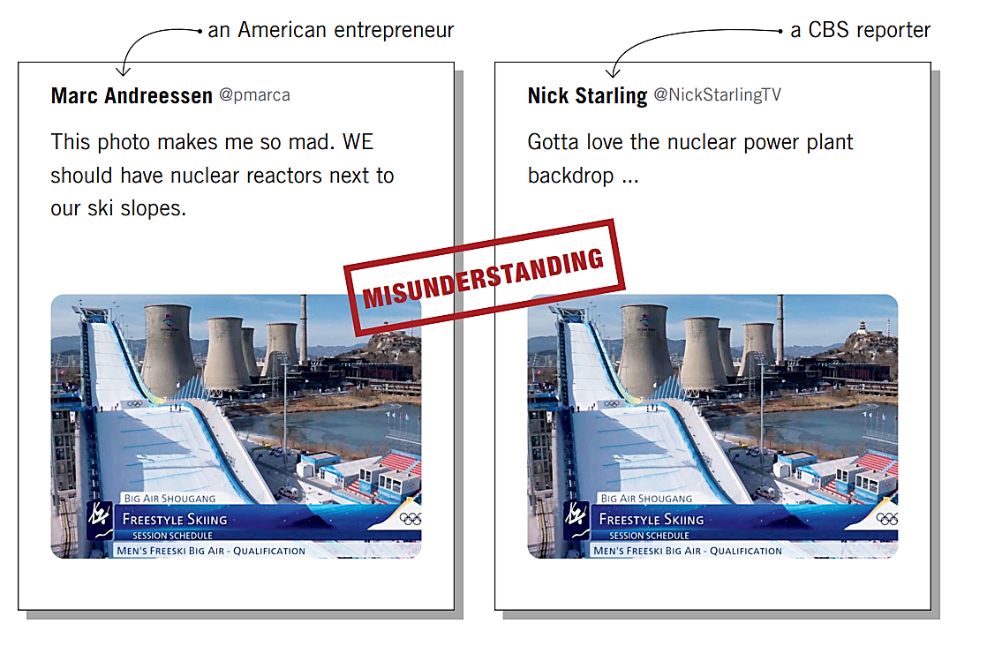
Western media perspectives
CASE STUDY
The following are some related comments from Twitter and an excerpt from a CNN report.
Unit 3 Beijing Olympic Games

Slide 35
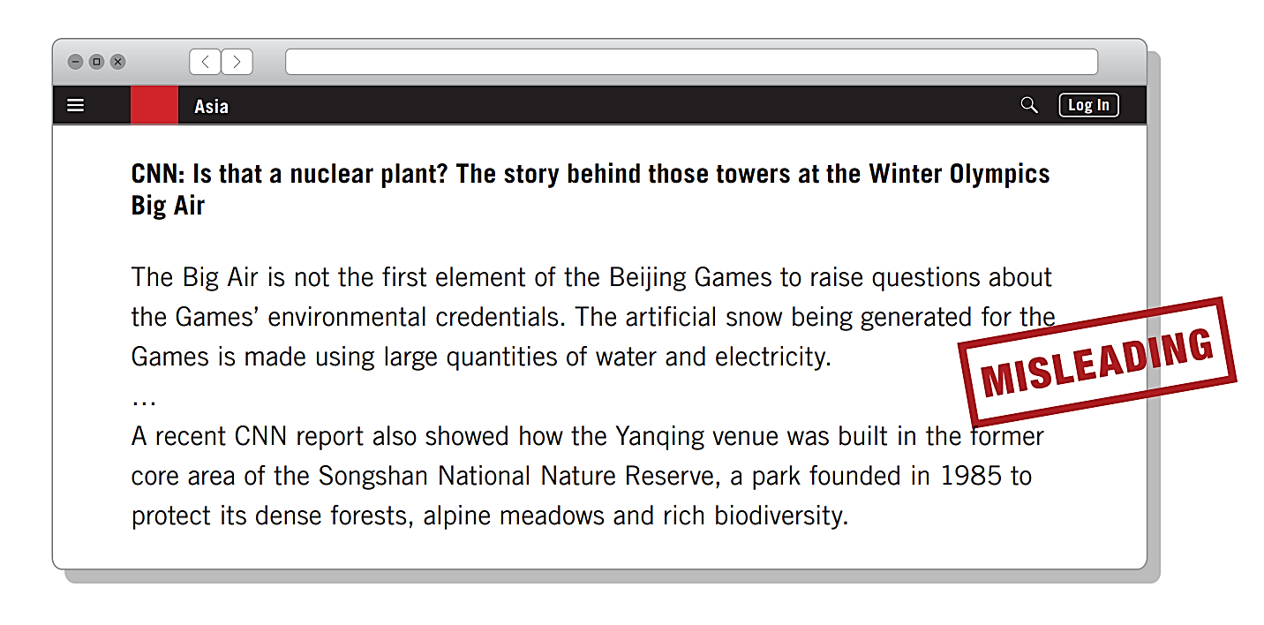
Western media perspectives
CASE STUDY
Unit 3 Beijing Olympic Games

Slide 36
Western media perspectives
CASE STUDY
Hyping the Big Air Shougang as a venue next to a “nuclear plant” is totally absurd and ridiculous. In fact, it has been repurposed from the site of a former steel plant of Shougang Group. And those big towers are simply cooling towers of the former steel mill. Thanks to its uniqueness and greenness, the Big Air Shougang is well recognized by many athletes, journalists, and the International Olympic Committee. What’s more, the so-called “environmental hazards” mentioned by CNN are not true.
The CNN report on the Yanqing venue is also fake. The boundaries of the Songshan National Nature Reserve were adjusted for better protection of the ecological environment. After the adjustment, the Yanqing venue does not fall in the reserve.
Unit 3 Beijing Olympic Games

Slide 37
Western media perspectives
CASE STUDY
Discussion
Work in pairs to discuss the following questions.
What are the problems with the Twitter comments and the CNN report?
What do you think are their purposes of relating the Big Air Shougang to a “nuclear plant”?
Unit 3 Beijing Olympic Games

Slide 38
Western media perspectives
CASE STUDY
Discussion
Work in pairs to discuss the following questions.
What are the problems with the Twitter comments and the CNN report?
The Twitter comments interpreted the photo of Big Air Shougang out of context, creating groundless rumors that the venue is next to a “nuclear plant.” The CNN report made use of the netizens’ misunderstanding to raise doubts and question the greenness of the Games.
Unit 3 Beijing Olympic Games

Slide 39
Western media perspectives
CASE STUDY
Discussion
Work in pairs to discuss the following questions.
What do you think are their purposes of relating the Big Air Shougang to a “nuclear plant”?
Their purposes may include finding so-called evidence to support their bias against China, and utilizing misinformation to intentionally cause trouble for the Beijing Olympics.
Unit 3 Beijing Olympic Games

Slide 40
Western media perspectives
MEDIA LITERACY
Out-of-context photos or videos
In the cases, the netizens interpreted photos or videos out of context, creating groundless rumors and distorting basic facts. The report made use of netizens’ misunderstanding to raise doubts and question the greenness of the Games. The relevant media concept in such cases is “out-of-context photos or videos,” which basically refer to the photos or videos that lack or misstate the context in which events occurred.
Two commonly seen tricks of out-of-context photos or videos are isolation and misrepresentation.
Isolation means presenting a visual element in an isolated way, without providing necessary background information for viewers to accurately understand what the visual element is actually depicting or the full story.
Misrepresentation means presenting unaltered content in an inaccurate way that misleads the viewers. Typically, it recirculates old legitimate photos or videos out of their original contexts and uses them as evidence for other things.
Unit 3 Beijing Olympic Games

Slide 41
Western media perspectives
MEDIA LITERACY
How did the netizens and the media report distort facts and raise doubts about the Big Air Shougang?
The netizens simply relied on out-of-context photos or videos and drew wild conclusions based on the strong contrast between the big towers and the ski slope, but didn’t bother to learn any necessary background information
The media report made use of netizens’ misunderstanding to pursue their own agenda: questioning the greenness of the Beijing 2022 Olympics.
In terms of language, three language patterns are used in the cases that we should be aware of.
exaggeration
irony
sensational headlines
Why did some Westerners relate the Big Air Shougang to a “nuclear plant”? Possible reasons:
lacking media literacy and blindly believing in out-of-context photos or videos;
finding so called evidence to support their bias against China;
utilizing misinformation to intentionally cause trouble for the Beijing Olympics.
Unit 3 Beijing Olympic Games

Slide 42
Western media perspectives
Key concept(s)
out-of-context photos or videos 脱离语境的图片或视频
Out-of-context photos or videos basically refer to the photos or videos that lack or misstate the context in which events occurred. Interpreting photos or videos out of context is an important cause of visual misinformation and can be particularly dangerous.
脱离语境的图片或视频是指未提供或错误描述事件发生语境的图片或视频。断章取义地解读图片或视频是导致视觉错误信息产生的重要原因，而且十分危险。
Unit 3 Beijing Olympic Games

Slide 43
Western media perspectives
Knowledge points
Visual elements are powerful tools to promote ideas and guide public opinions. 视觉元素是宣扬观点和引导舆论的有力工具。
Two commonly seen tricks of out-of-context photos or videos are isolation and misrepresentation. 脱离语境的图片或视频有两种常见的表现方式：孤立和歪曲。
Isolation means presenting a visual element in an isolated way, without providing necessary background information for viewers to accurately understand what the visual element is actually depicting or the full story. 孤立是指孤立呈现某个视觉元素，不给观众提供必要的背景信息，让观众无法准确理解该视觉元素实际上描述的是什么或看不到事物的全貌。
Isolation can also happen when clips are taken from a complete video, which sometimes creates a false narrative that does not reflect the whole picture. 从完整的视频中截取片段也会产生孤立的效果，这有时会导致不能反映事情全貌的错误叙事。
Unit 3 Beijing Olympic Games

Slide 44
Western media perspectives
Knowledge points
Misrepresentation means presenting unaltered content in an inaccurate way that misleads the viewers. Typically, it recirculates old legitimate photos or videos out of their original contexts and uses them as evidence for other things. 歪曲是指以一种误导观众的不准确方式来呈现未改动的内容。通常情况下，它将以往正当合理的照片或视频从原始语境中剥离出来重新传播，并将其用作其他事情的证据。
Misrepresentation may involve the change of the shooting date or location, or both, while the visual content remains the same. This change of the context will also mislead the viewers. 歪曲可能涉及在视觉
Since context plays an important role in image and video interpretation, it’s necessary for us to take context into consideration when interpreting visual elements, and to provide necessary context when presenting and transmitting pictures or videos. 既然语境在解读图像和视频中扮演着重要角色，那么我们在理解视觉元素时就需要考虑语境，在呈现和传播图片或视频时也需要提供必要的语境。
Unit 3 Beijing Olympic Games

Slide 45
Western media perspectives
MEDIA LITERACY
Understanding
2 Answer the following questions according to what you have learned.
What are out-of-context photos or videos?
Why is the Big Air Shougang a good example of urban planning, representing sustainability, frugality, and greenness?
How can you refute the Western netizens’ false views?
Unit 3 Beijing Olympic Games

Slide 46
Western media perspectives
MEDIA LITERACY
Understanding
2 Answer the following questions according to what you have learned.
(1) What are out-of-context photos or videos?
They basically refer to the photos or videos that lack or misstate the context in which events occurred.
Unit 3 Beijing Olympic Games

Slide 47
Western media perspectives
MEDIA LITERACY
Understanding
2 Answer the following questions according to what you have learned.
(2) Why is the Big Air Shougang a good example of urban planning, representing sustainability, frugality, and greenness?
This is because the Big Air Shougang is the first competition venue repurposed from an industrial heritage site in the history of Winter Olympics. It is also the world’s first permanent big air venue for long-term usage, such as for tourism, art exhibitions, and sports events.
Unit 3 Beijing Olympic Games

Slide 48
Western media perspectives
MEDIA LITERACY
CASE STUDY
Understanding
2 Answer the following questions according to what you have learned.
(3) How can you refute the Western netizens’ false views?
The Western netizens’ false views distorted the fact that the venue is actually built in the site of a former steel plant of Shougang Group. Those big towers are simply cooling towers of the former steel mill. Opposite to the so-called “environmental hazards,” the venue is a good example of urban planning, representing sustainability, frugality, and greenness.
Unit 3 Beijing Olympic Games

